Slide 1
Budget sales analysis
Sameera banu m

Slide 2
contents
Problem Statement
Key metrics and Overview
My Dashboard
Analysis Process
Recommendations & Summary

Slide 3
Problem statement
Our "Domain Sale" process is structured to help potential buyers purchase the domain they want immediately without the hassle of contacting the seller directly. A seller lists a domain for sale at a specific price in our Marketplace. An interested buyer sees this domain for sale and decides to buy it. Extract various information such as Sales, budget, and variance. You can even compare sales and budgets with various attributes. Extract necessary information about Products and Customers. Make the necessary dashboard with the best you can extract from the data. Use various visualization and features and make the best dashboard. Find key metrics and factors and show the meaningful relationships between attributes. Do your own research and
come up with your findings.

Slide 4
Key metrics and overview
Total Products: 504
Total Revenue: $29.31 million
Average Sales Amount: $503.67
Average Sales Amount per Product: $225.44K
Total List Price: 121
Profit Earned: $12.05 million

Slide 5
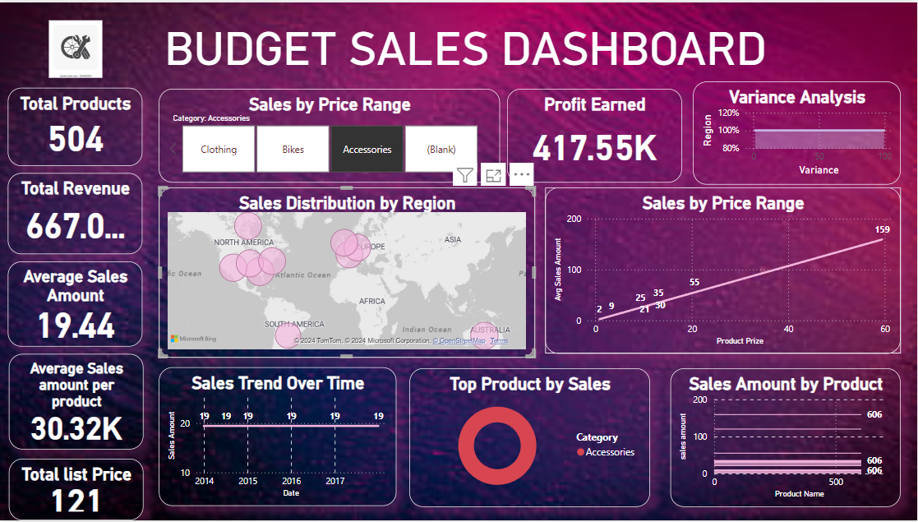
My dashboard

Slide 6
Analysis process
Sales Analysis by Price Range
Findings:
Sales are segmented into different price ranges, with higher-priced items generating more revenue.Significant sales were observed in the upper price brackets, indicating strong market demand for premium products.

Slide 7
Analysis process
Financial Overview and Variance Analysis
Findings:
Profit Earned: A robust profit of $12.05 million, indicating efficient cost management. The variance analysis shows regional performance differences, with some regions meeting or exceeding 100% of targets, while others fall short. A strong profit margin relative to total revenue ($29.31 million) suggests healthy financial stability.

Slide 8
Analysis process
Product Performance Insights
Findings:
The sales trend shows consistency from 2014 to 2017, maintaining a stable performance across these years.The products under the bike category achieved the greater profit.

Slide 9
Recommendation & Summary
Focus on increasing sales in underperforming regions.
Continue leveraging high-revenue product categories.
Explore new market opportunities.

Slide 10
THANK YOU
SAMEERA BANU M
sameeramansoor03@gmail.com

